Slide 1

Prediction of Bike Share Demand
-EL-GY 9123 Introduction to Machine Learning Final Project
Hongyi Sun(hs3497) Qiongxuan Tan(qt310)
Date: 05/16/2018

Slide 2
Project Abstract:
With the popularity of shared bike in big cities like San Francisco, it is becoming more and more important to predict the real demand of shared bike based on previous data.
We try to predict the daily demand of shared bike and duration of each trip based on several weather and date features.
Since there are several features and targets, we consider it as a multi-regression problem. We got data from Kaggle.com[1] and try to fit it in models we learned in class, such as linear regression, LASSO regression, and neural network. We compare the accuracies of different models to get the optimized solution. After getting different accuracies from these models, we will discuss how to improve it in future work
[1] https://www.kaggle.com/benhamner/sf-bay-area-bike-share

Slide 3
Project Abstract:
1
Linear Regression
Multi-Regression Problem
2
LASSO Regression
3
Neural Network

Slide 4
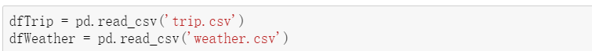
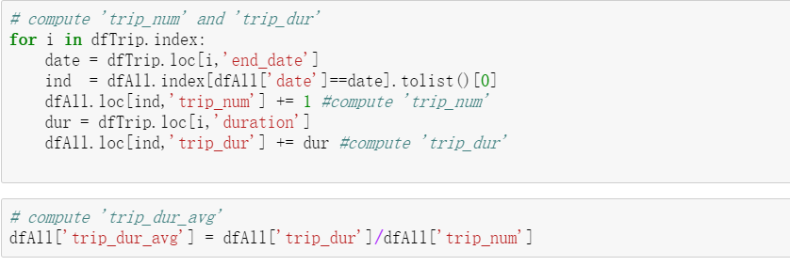
Build Dataset:
Selection of features and targets
1. Read data from trip.csv and weather.csv.
2. Compute the daily trip numbers and average durations. In this step, we explore end date of each trip, count all trips with same end date as daily trip number, and use mean of their durations as average trip duration.

Slide 5
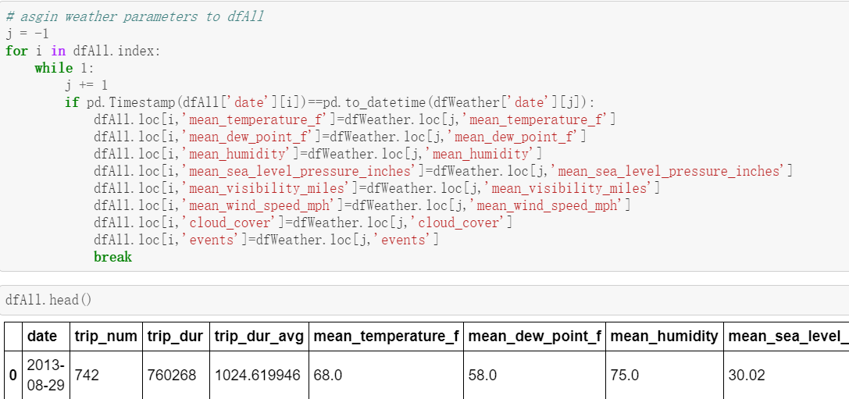
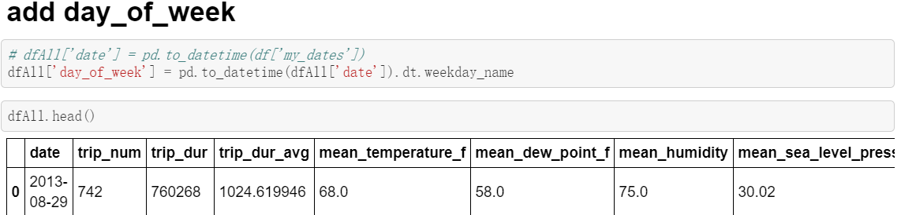
Build Dataset:
Selection of features and targets
Match weather parameters with daily trip parameters. In this step, we choose weather features like temperature, dew point, humidity, sea level, visibility, wind speed, cloud cover and events
We also add the day of week feature by common sense since it is supposed to have difference demands between workdays and weekends.

Slide 6
Build Dataset:
Selection of features and targets
Features:
date, mean_temperature_f, mean_dew_point_f, mean_humidity, mean_sea_level_pressure_inches, mean_visibility_miles, mean_wind_speed_mph, cloud_cover, events
Targets: trip_num, trip_dur_avg

Slide 7
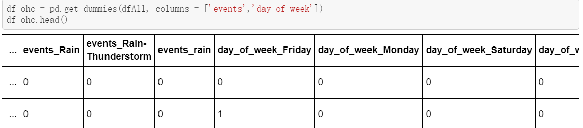
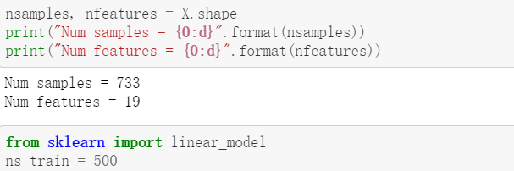
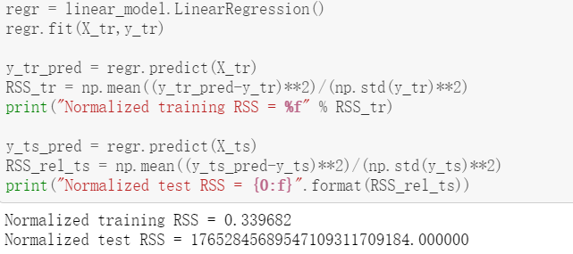
Linear Regression:
Use one hot coding in feature ‘events’ and ‘day of week’, set number of training samples to 500 and the rest for test.
Even though the normalized training RSS is small, the linear regression model still fails because the normalized test RSS is extremely large, this is because overfitting due to large number of parameters and relatively small number of samples, which lead to large errors in test dataset.
Therefore, we try to use LASSO regression to select optimal features.

Slide 8
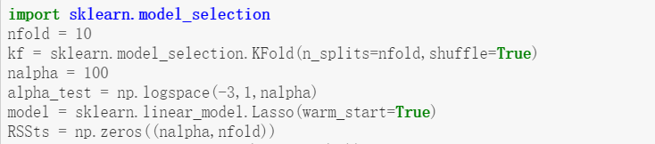
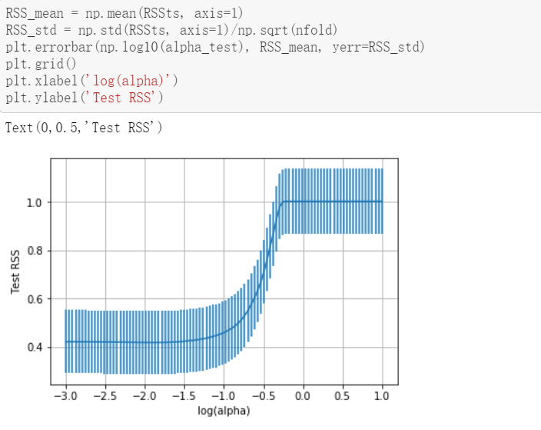
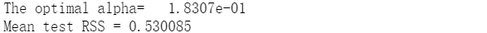
LASSO Regression:
Use cross validation to select the regularization level alpha. Choose 100 alpha values logarithmically spaced from 1e-3 to 10 and 10 fold for cross validation. Store the test RSS in a matrix RSSts with rows correponding to different alpha values and columns corresponding to different cross validation folds.
Determine the RSS mean and standard error corresponding to different alpha and plot the mean RSS with error bar as a function of alpha.
Find the optimal alpha and the mean test RSS at this optimal point using the one standard error rule.
The mean test RSS is 0.530085 after LASSO regularization, which is a reasonable result.

Slide 9
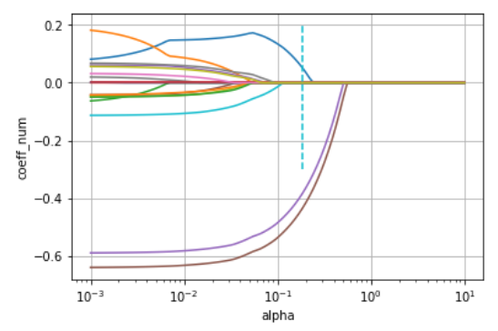
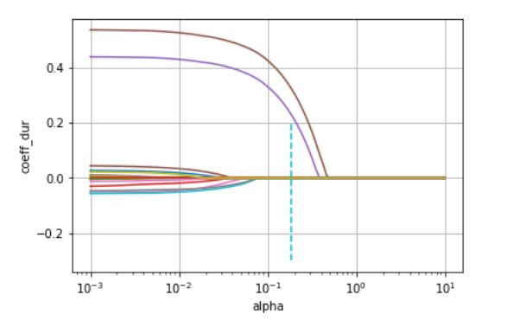
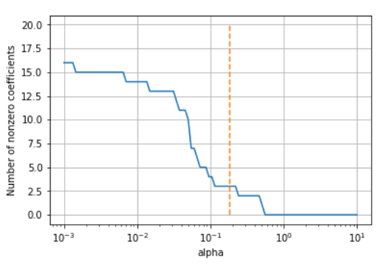
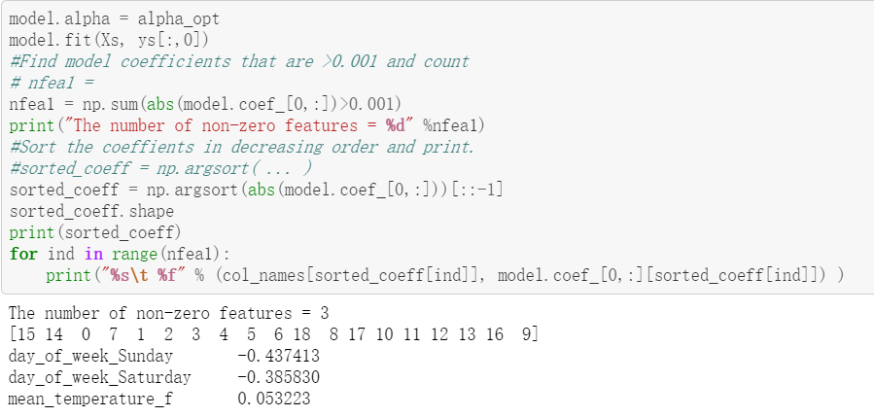
LASSO Regression:
We also draw the LASSO path for both trip numbers and trip durations to illustration the effect of LASSO regularization, we can see from the figure that features with large coefficients are the same.
Find the number of non-zero LASSO coefficients, which is 3, and the corresponding feature names are day_of_week_Sunday, day_of_week_Saturday and mean_temperature_f.
These coefficients actually make sense in real life.

Slide 10
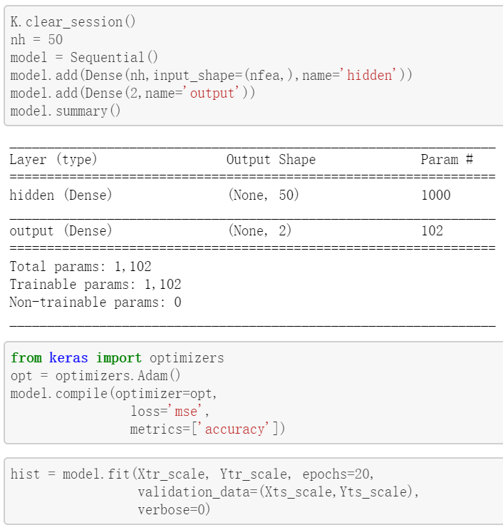
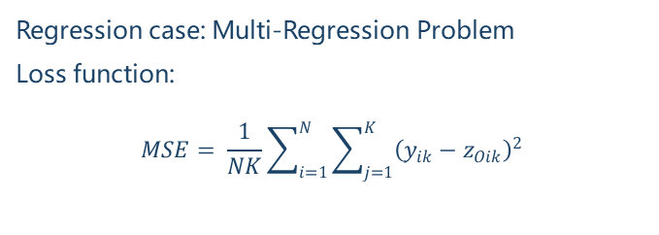
Neural Network:
Build a 2 layers Neural Network
Regression case: Multi-Regression Problem
Loss function:
$$MSE= \frac{1}{NK}\sum_{i=1}^{N}{\sum_{j=1}^{K}{{\left(y_{ik}−z_{Oik}\right)}^{2}}}$$

Slide 11
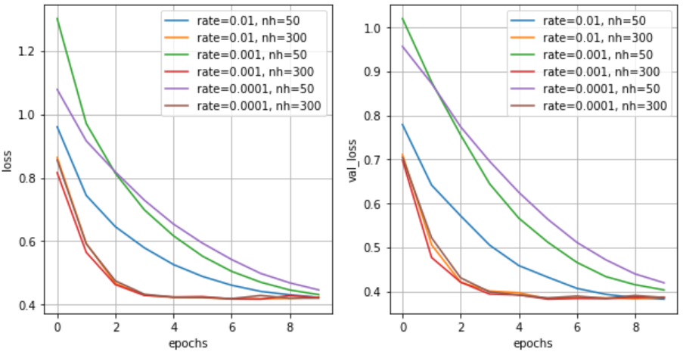
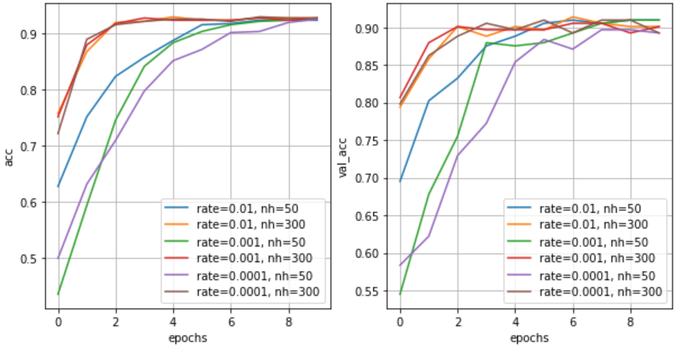
Neural Network:
Optimizing parameters
To optimize the result of a 2 layer neural network, we trained the network using different learning rates and numbers of hidden units listed as follow:
Learning rates(rate): 0.01, 0.001, 0.0001
Lumbers of hidden units(nh): 50, 300
From the resulting losses and accuracies, it is obvious that using large number of hidden units converges faster. When using 300 hidden units, the best learning rate is 0.001.

Slide 12
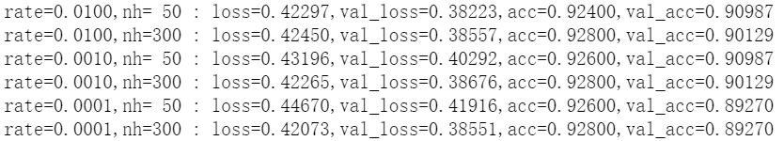
Neural Network:
Final results
The final results using different parameters are similar. The best accuracy is 92.80%, validation accuracy is 90.13%, with learning rate 0.01 and number of hidden units 300.

Slide 13
Conclusion and Future Work:
We performed linear regression, LASSO regression and neural network regression to predict the demand for bikes at bike share stations, as a function of day of week, temperature, and wind speed and so on.
In future work, we can predict the numbers and duration of bike trips as a function of age and gender of customer. Also, for weather data, we could divide it into 24 hour periods, and the demand of shared bike may have relationship with daytime and nighttime. It would also be interesting to model trips between pairs of stations, and build models to predict the destination given customer information and starting station.

Slide 14

THANKS

